Slide 1
MEDICAL STORE MANAGEMENT SYSTEM
Presented by:
Hrshvardhan Tiwari
Roll No. - 303302223101
CSE - 4th semester

Slide 2
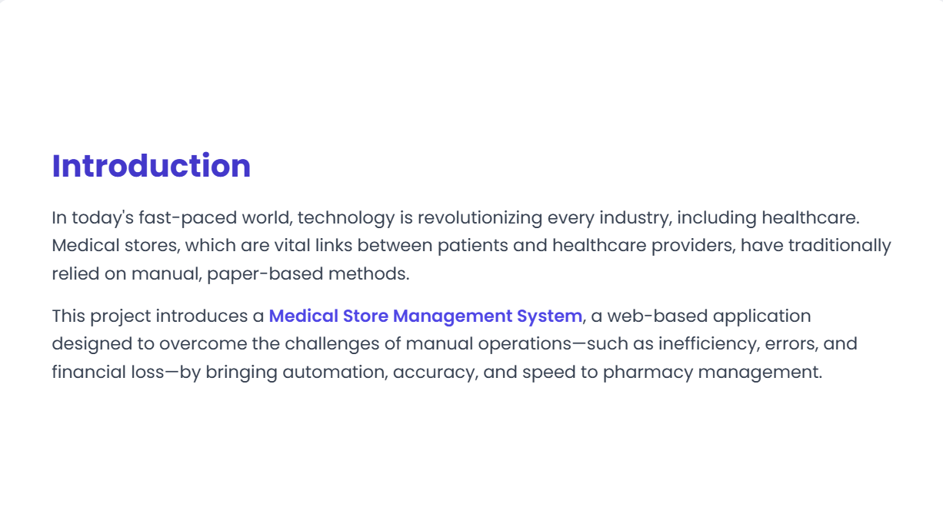
Slide 2: Introduction

Slide 3
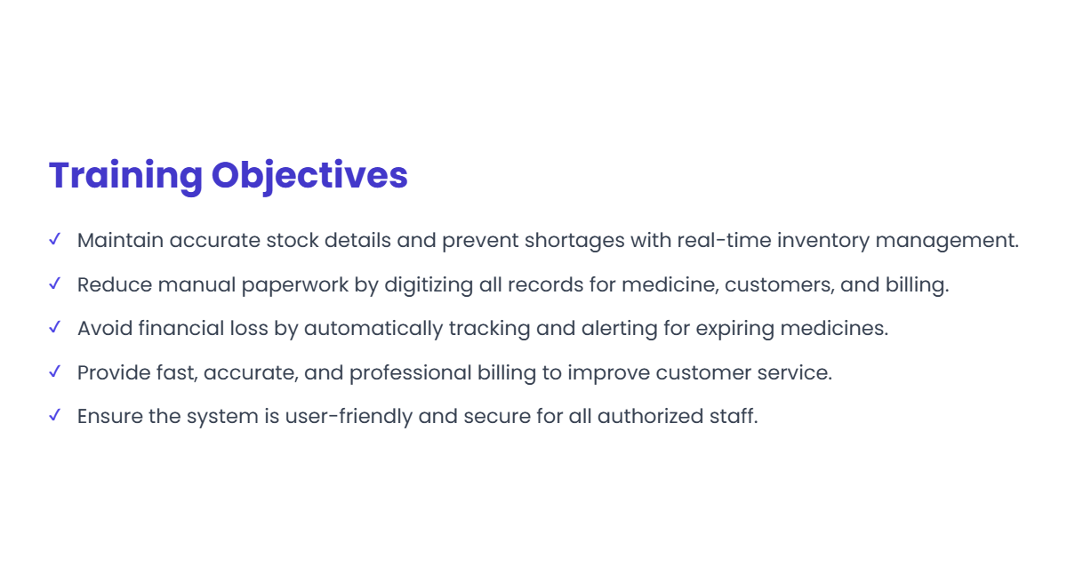
Slide 3: Training Objectives

Slide 4
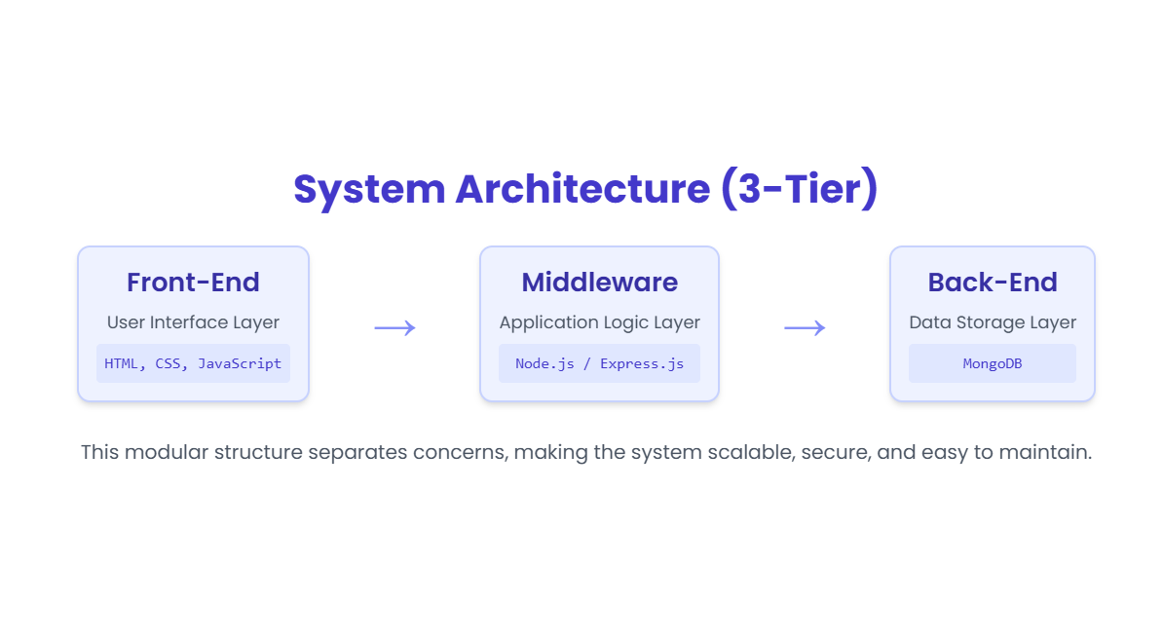
Slide 4: Training Modules / Topics Covered

Slide 5
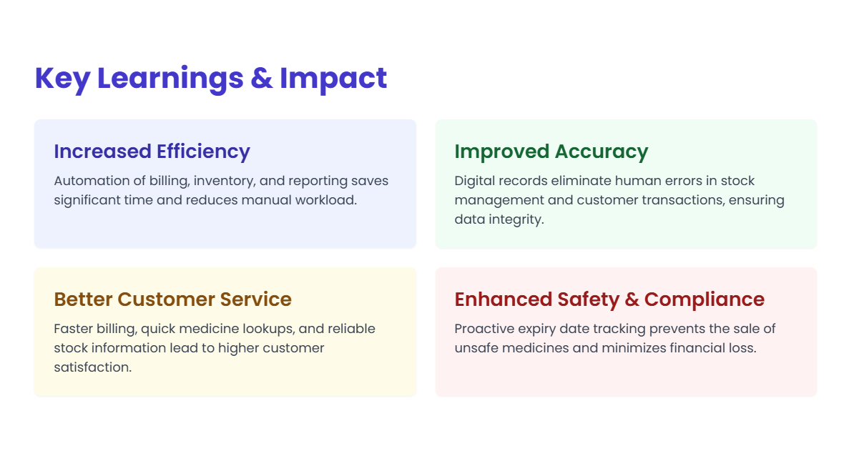
Slide 5: Key Learnings

Slide 6

Slide 6: Project Title & Introduction

Slide 7
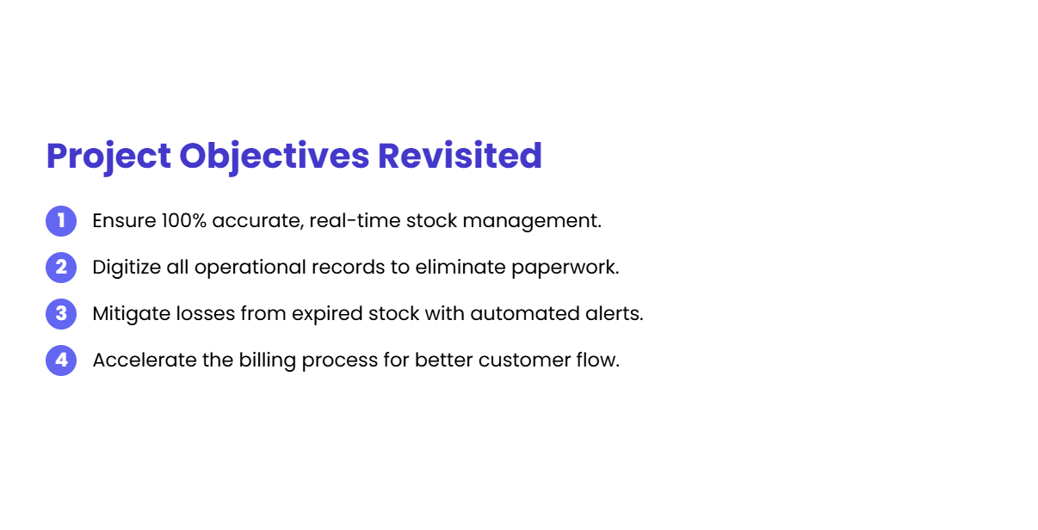
Slide 7: Project Objectives

Slide 8
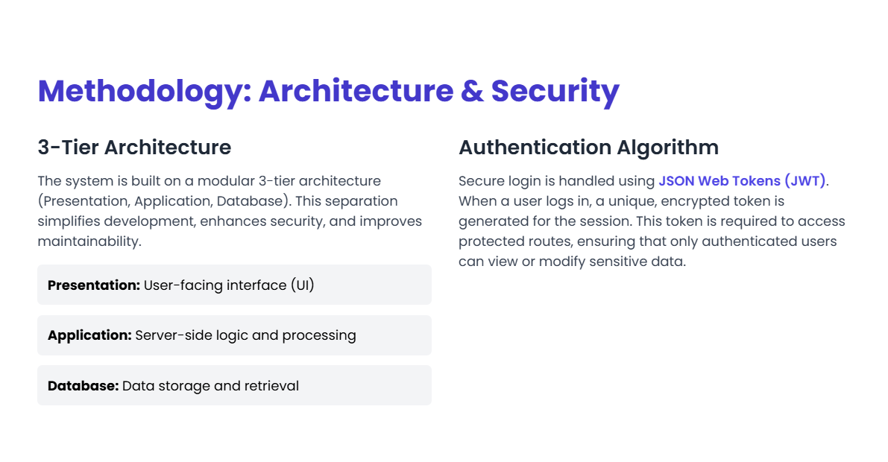
Slide 8: Methodology / Approach 1

Slide 9

Slide 9: Methodology / Approach 2

Slide 10
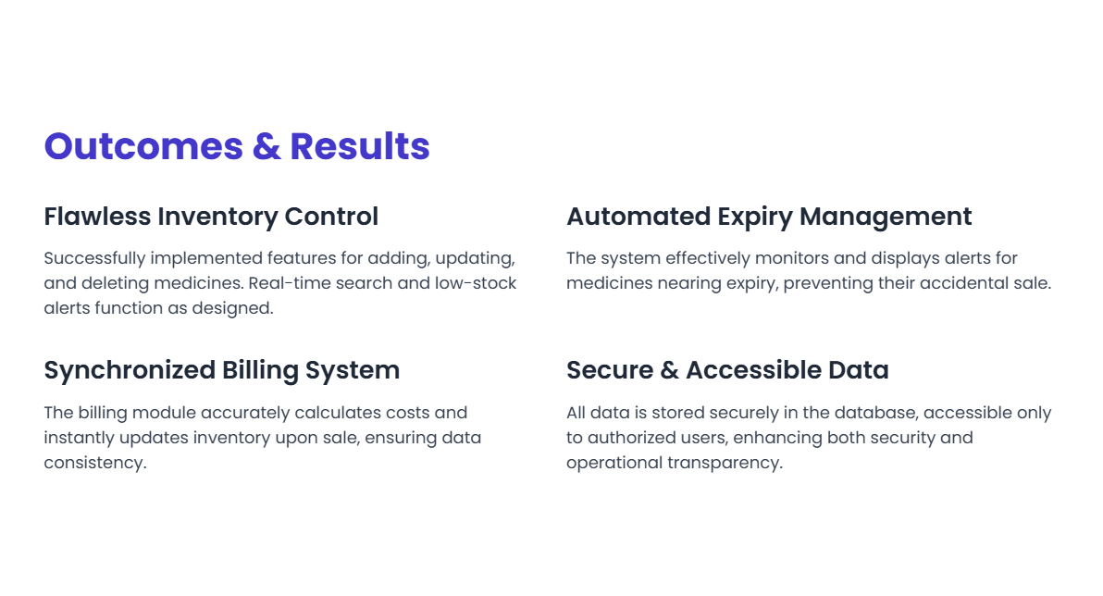
Slide 10: Project Work Details

Slide 11
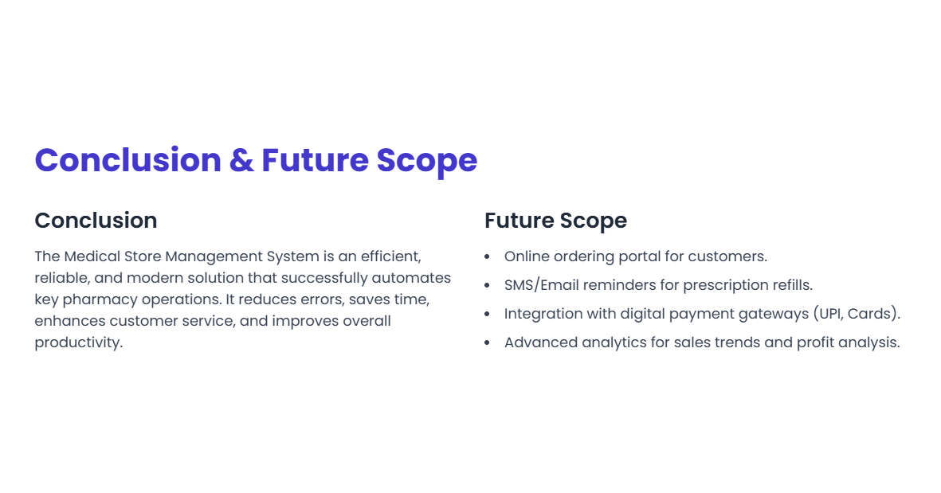
Slide 11: Outcomes & Results

